Slide 1

iCode
DAY 4
EMPOWERING FUTURE INNOVATORS
Day 4 — VR Camp
2-Player Fighter · 1999 · Smash Bros Era
1

Slide 2
iCode
DAY 4
EMPOWERING FUTURE INNOVATORS
Why fighters matter
• 1984: Karate Champ — two-player on one screen, invented the genre.
• 1992: Street Fighter II goes to arcades — quarter-eating, combos, characters with personalities.
• 1999: Super Smash Bros — stock lives, platform stages, no health bars, four players. Chaos perfected.
• 2D fighters are the petri dish where character stats, state machines, and hitboxes were invented.
2

Slide 3
iCode
DAY 4
EMPOWERING FUTURE INNOVATORS
Yesterday → Today
• D3: Functions + Lists — every enemy is a dict in a list; functions scan it every frame.
• D4: Objects + State — every fighter is an object that remembers its own HP and knows what it's doing right now.
• Shift: from "a list of dicts" → "a class that gives each fighter its own memory."
3

Slide 4
iCode
DAY 4
EMPOWERING FUTURE INNOVATORS
5-day arc
• D1: Variables + Conditions — Racer
• D2: Loops + Functions (intro) — Maze
• D3: Functions (deep) + Lists — Base Defense
• D4: Objects + State — Fighter ← you are here
• D5: No new code — Showcase
4

Slide 5
iCode
DAY 4
EMPOWERING FUTURE INNOVATORS
Two new ideas today
• OBJECTS — a fighter that remembers its own stats and handles its own damage.
• STATE — a fighter that knows what it's doing right now (idle / walk / jump / attack / hit / dead).
5

Slide 6
iCode
DAY 4
EMPOWERING FUTURE INNOVATORS
Pre-coding setup
7

Slide 7
iCode
DAY 4
EMPOWERING FUTURE INNOVATORS
Open the Day 4 project
• Open the Day 4 Fighter project the same way you did yesterday.
8

Slide 8
iCode
DAY 4
EMPOWERING FUTURE INNOVATORS
Open player.gd
• Open player.gd in the script editor — this is where most of today's chunks live.
10

Slide 9
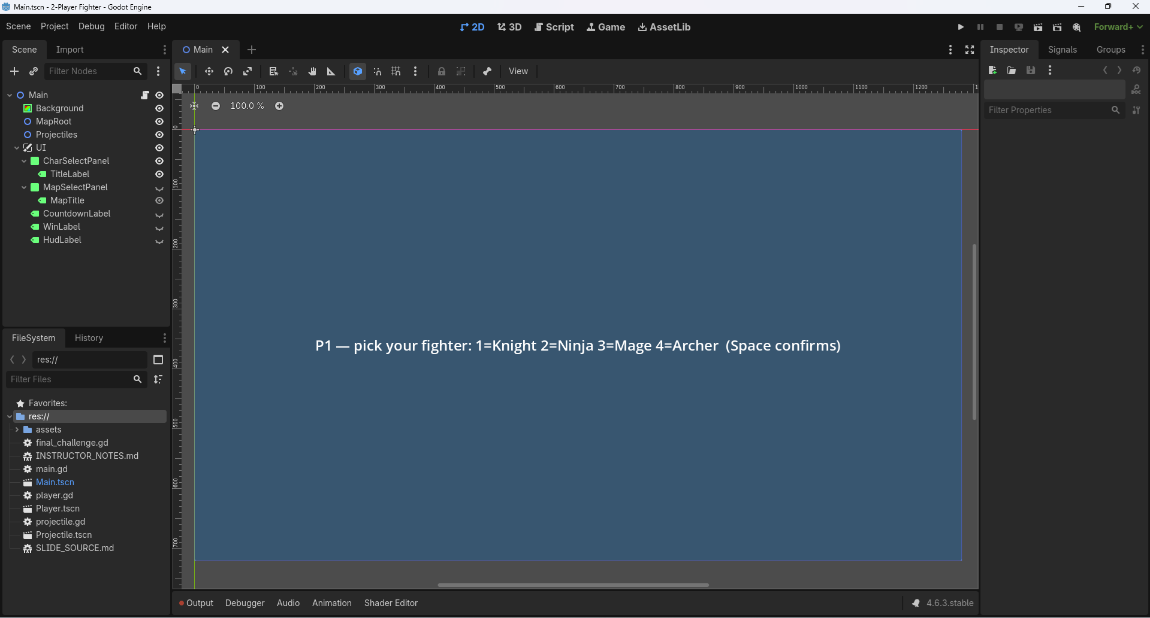
iCode
DAY 4
EMPOWERING FUTURE INNOVATORS
The menus already work
12

Slide 10
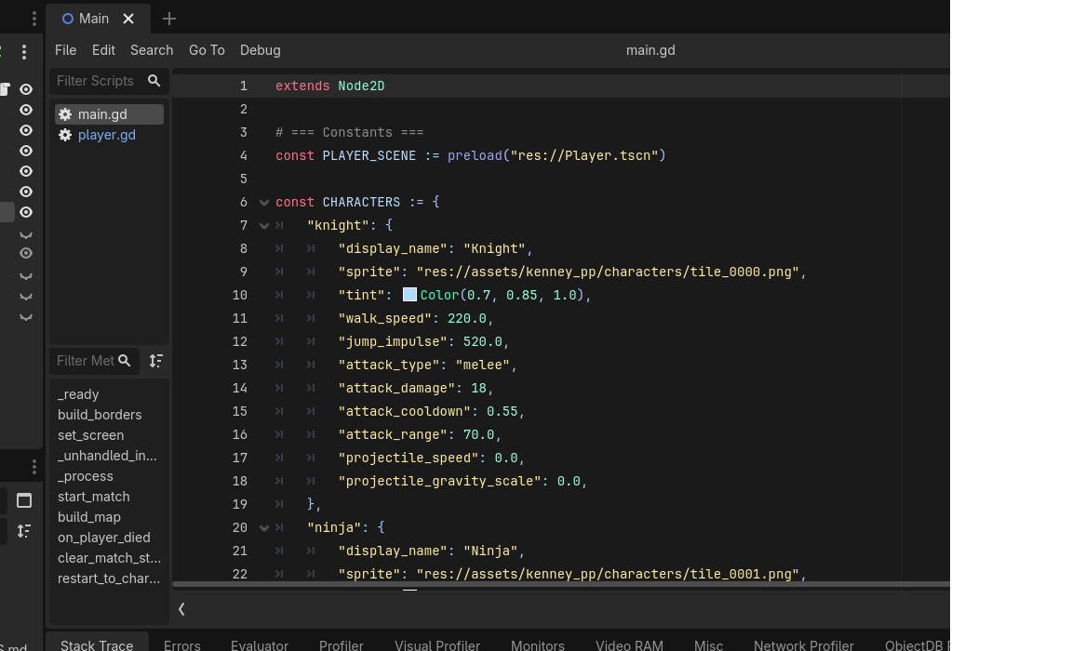
iCode
DAY 4
EMPOWERING FUTURE INNOVATORS
The CHARACTERS dict
13

Slide 11
iCode
DAY 4
EMPOWERING FUTURE INNOVATORS
11 properties per character
• display_name — shown in char-select panel
• sprite — path to the Kenney sprite PNG
• tint — Color(R, G, B) tint applied via Modulate
• walk_speed — pixels/second horizontal movement
• jump_impulse — upward velocity on jump
• attack_type — "melee" or "projectile"
• attack_damage — HP removed per hit
• attack_cooldown — seconds between attacks
• attack_range — melee reach in pixels
• projectile_speed — speed of fired projectile
• projectile_gravity_scale — how fast projectile falls
14

Slide 12
iCode
DAY 4
EMPOWERING FUTURE INNOVATORS
Each character is a dict. Each fighter will be an object.
• Right now: characters are dicts — plain data, no behaviour.
• Today: the Player class gets the same property names — so each Player object owns its own copy of those values.
• When setup() runs, it copies from the dict into the object. Knight's walk_speed → self.walk_speed.
15

Slide 13
iCode
DAY 4
EMPOWERING FUTURE INNOVATORS
Meet the pandas
16

Slide 14
iCode
DAY 4
EMPOWERING FUTURE INNOVATORS
OBJECT
An object is a thing in code that remembers its own data.
17

Slide 15
iCode
DAY 4
EMPOWERING FUTURE INNOVATORS
Blueprint vs panda
• Class = the blueprint. Describes what kind of data a panda has. Written once.
• Instance = one actual panda, created from that blueprint. Has its own copy of every property.
• Three pandas on screen → three instances. One blueprint → the Panda class.
18

Slide 16
iCode
DAY 4
EMPOWERING FUTURE INNOVATORS
Properties + Methods
• Property = a piece of data the object remembers. hp, hunger, personality.
• Method = something the object can do. eat(), take_damage(), die().
• Every instance has its own property values — but shares the same methods.
19

Slide 17
iCode
DAY 4
EMPOWERING FUTURE INNOVATORS
Quick check
• Panda A: hp = 80, hunger = 30.
• P1 attacks Panda A → take_damage(15) → Panda A hp = 65.
• Does Panda B's hp change?
• Answer: No. Each instance has its own hp. Damage to A doesn't touch B.
20

Slide 18
iCode
DAY 4
EMPOWERING FUTURE INNOVATORS
Panda class in GDScript
class Panda:
var hp := 100
var hunger := 0
var personality := "lazy"
func take_damage(amount):
hp -= amount
if hp <= 0:
die()
func die():
print(personality, " panda fainted")
21

Slide 19
iCode
DAY 4
EMPOWERING FUTURE INNOVATORS
7 panda personalities
• lazy — sits around, minimal movement
• playful — chases other pandas
• aggressive — attacks on sight
• nervous — runs away
• hungry — seeks bamboo
• sleepy — falls asleep mid-fight
• sneezy — random sneeze knocks back nearby pandas
22

Slide 20
iCode
DAY 4
EMPOWERING FUTURE INNOVATORS
Objects everywhere in games
• Every enemy is an object — its own HP, position, and AI state.
• Every bullet is an object — its own speed, direction, and damage.
• Every item on the ground is an object — its own type and pickup range.
• The game loop just calls methods on them: enemy.update(delta), bullet.move(delta).
23

Slide 21
iCode
DAY 4
EMPOWERING FUTURE INNOVATORS
One class. Two fighters.
• One Player class (in player.gd).
• Instantiated twice — once for P1, once for P2.
• Each instance has its own hp, state, position, and character stats.
• They share the same methods: take_damage(), attack(), set_state().
24

Slide 22
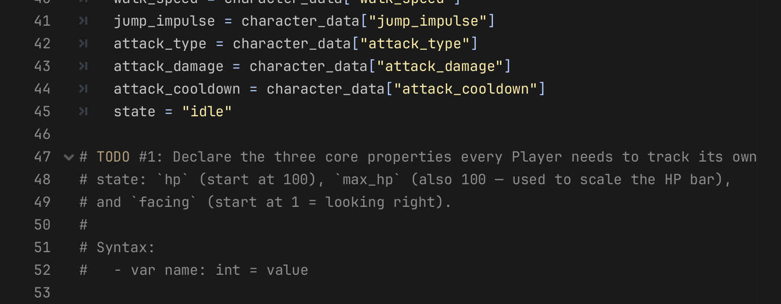
iCode
DAY 4
EMPOWERING FUTURE INNOVATORS
Declare the three things every Player needs to remember about itself: hp (start at 100), max_hp (also 100, for the HP bar), and facing (start at 1 = looking right).
Pattern (board example):
Where in your code (Godot):
var hp := 100
var max_hp := 100
var facing := 1
26

Slide 23
iCode
DAY 4
EMPOWERING FUTURE INNOVATORS
No visible payoff yet
Chunk #1 adds properties the game will use — but nothing appears on screen until chunk #4. Keep going.
27

Slide 24
iCode
DAY 4
EMPOWERING FUTURE INNOVATORS
Run the game — confirm no errors
• Run the game and confirm it opens without errors.
28

Slide 25
iCode
DAY 4
EMPOWERING FUTURE INNOVATORS
Remember what KIND of panda it is
Every fighter has different stats — Knight hits hard, Ninja moves fast. Those differences live in the CHARACTERS dict. Now we pull them into the object.
32

Slide 26
iCode
DAY 4
EMPOWERING FUTURE INNOVATORS
Dict → setup() → object vars
• The CHARACTERS dict in main.gd holds raw stat values for each character.
• setup(char_key, player_num) runs once when a fighter spawns — it reads the dict and copies values into self properties.
• After setup(), the fighter knows its own walk_speed, attack_damage, etc. — no more looking up the dict.
33

Slide 27
iCode
DAY 4
EMPOWERING FUTURE INNOVATORS
Quick check
• P1 picks Knight (walk_speed: 220.0). P2 picks Ninja (walk_speed: 310.0).
• After setup() runs for each fighter, what is p1.walk_speed? What is p2.walk_speed?
• Answer: p1.walk_speed = 220.0, p2.walk_speed = 310.0. Independent copies.
34

Slide 28
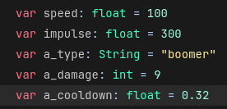
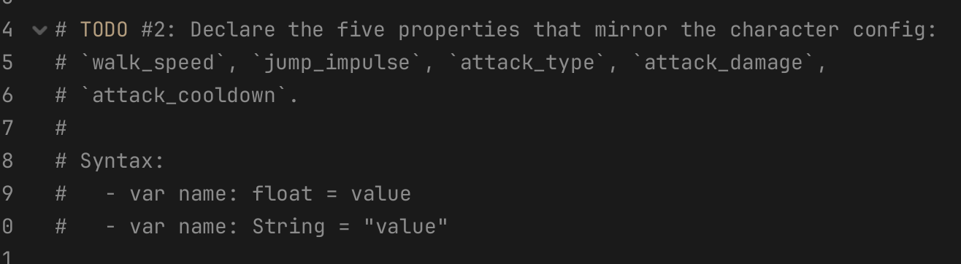
iCode
DAY 4
EMPOWERING FUTURE INNOVATORS
Declare the five properties that mirror the character config: `walk_speed`, `jump_impulse`, `attack_type`, `attack_damage`, `attack_cooldown`.
Pattern (board example):
Where in your code (Godot):
36

Slide 29
iCode
DAY 4
EMPOWERING FUTURE INNOVATORS
Like teaching the panda how to lose health…
We’ll teach our characters how to lose HP
Properties store data. Methods make the object do something. Now we write the fighter's first method.
37

Slide 30
iCode
DAY 4
EMPOWERING FUTURE INNOVATORS
A method changes an object's own data
class Panda:
var hunger := 50
func feed():
hunger -= 10
print("Panda ate. Hunger now:", hunger)
38

Slide 31
iCode
DAY 4
EMPOWERING FUTURE INNOVATORS
Pieces already in the file
• hp — the property you declared in chunk #1.
• max_hp — also from chunk #1; used to compute HP bar fill ratio.
• hit_flash_timer — pre-given float; set it to 0.2 to trigger a flash effect.
• set_state(new_state) — pre-given stub (chunk #5 fills it); call it with "hit".
• die() — pre-given method; call it when hp hits zero.
• $HPBar — pre-given node; set scale.x = hp / max_hp to shrink the bar.
39

Slide 32
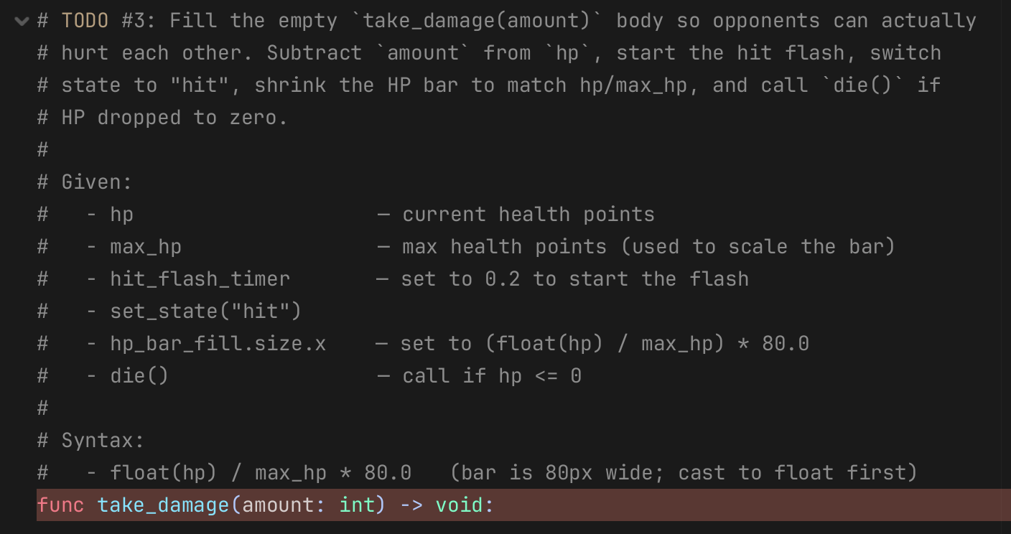
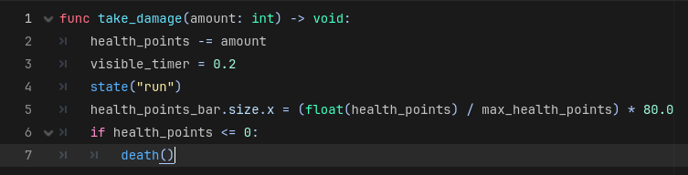
iCode
DAY 4
EMPOWERING FUTURE INNOVATORS
Fill the empty `take_damage(amount)` body so opponents can actually hurt each other. Subtract `amount` from `hp`, start the hit flash, switch state to "hit", shrink the HP bar to match hp/max_hp, and call `die()` if HP dropped to zero.
Pattern (board example):
Where in your code (Godot):
41

Slide 33
iCode
DAY 4
EMPOWERING FUTURE INNOVATORS
Time to spawn two of them
The Player class exists. The properties are declared. Now we create two instances — one for each player — and put them in the scene.
42

Slide 34
iCode
DAY 4
EMPOWERING FUTURE INNOVATORS
Panda.new() × 2
# Two independent instances from one blueprint
var panda_a = Panda.new()
var panda_b = Panda.new()
panda_a.hp = 80 # only A changes
print(panda_b.hp) # still 100 — B is unaffected
43

Slide 35
iCode
DAY 4
EMPOWERING FUTURE INNOVATORS
In Godot: PLAYER_SCENE.instantiate()
• Panda.new() in plain GDScript = PLAYER_SCENE.instantiate() in Godot.
• Both create a fresh copy of the blueprint.
• After instantiate(), call add_child() to put it in the scene tree, then setup() to load character data.
44

Slide 36
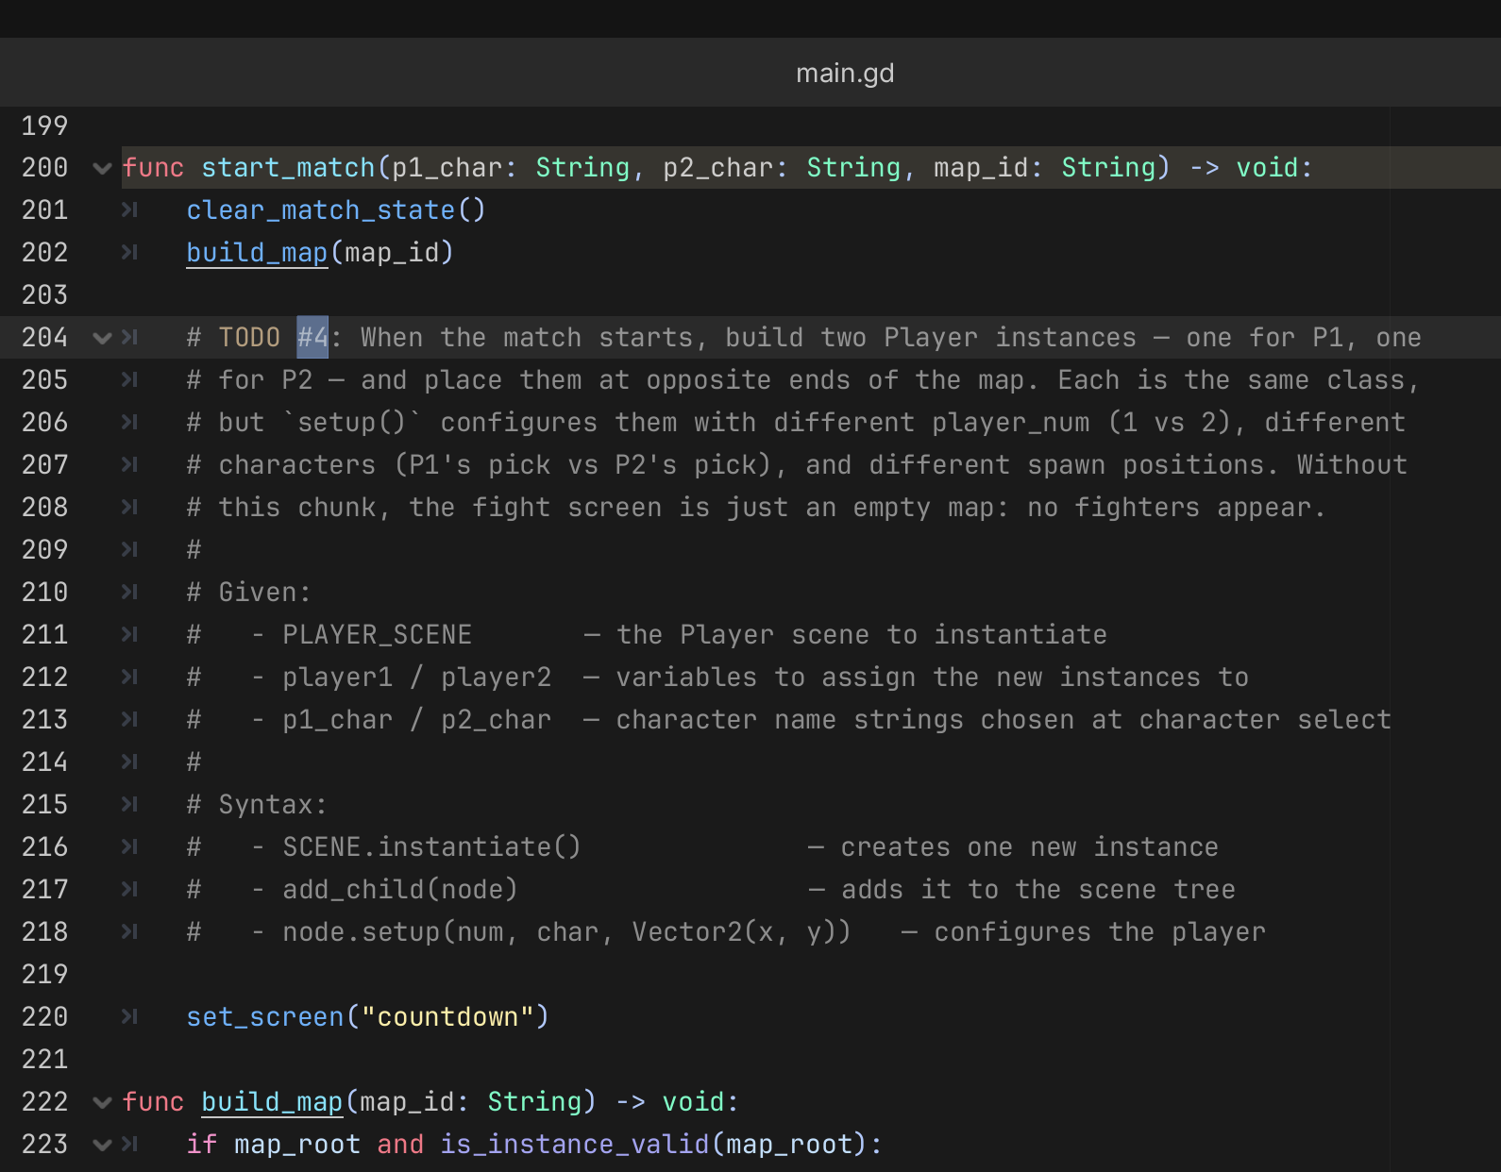
iCode
DAY 4
EMPOWERING FUTURE INNOVATORS
Where you'll type it — main.gd:205-212
45

Slide 37
iCode
DAY 4
EMPOWERING FUTURE INNOVATORS
Instantiate the Player scene twice — once for Player 1, once for Player 2. Add each to the tree and call setup() — Player 1 at Vector2(200, 500), Player 2 at Vector2(1080, 500).
Pattern (board example):
Where in your code (Godot):
# Panda analogy:
panda_a = PANDA_SCENE.instantiate()
add_child(panda_a)
panda_a.setup(1, panda_a_char, Vector2(200, 500))
panda_b = PANDA_SCENE.instantiate()
add_child(panda_b)
panda_b.setup(2, panda_b_char, Vector2(1080, 500))
46

Slide 38
iCode
DAY 4
EMPOWERING FUTURE INNOVATORS
Objects can change mode.
47

Slide 39
iCode
DAY 4
EMPOWERING FUTURE INNOVATORS
What does the traffic light know?
48

Slide 40
iCode
DAY 4
EMPOWERING FUTURE INNOVATORS
STATE
A state is a mode — one string that tells the object what it's doing right now.
49

Slide 41
iCode
DAY 4
EMPOWERING FUTURE INNOVATORS
State controls behavior
State What the light does
"red" Cars must stop. Pedestrians walk.
"yellow" Cars slow down. No new pedestrians.
"green" Cars go. Pedestrians wait.
50

Slide 42
iCode
DAY 4
EMPOWERING FUTURE INNOVATORS
States change on events
• Timer runs out → "red" → "green"
• Timer runs out → "green" → "yellow"
• Timer runs out → "yellow" → "red"
• A state machine: a set of states + the rules for switching between them.
51

Slide 43
iCode
DAY 4
EMPOWERING FUTURE INNOVATORS
State machine in GDScript
class TrafficLight:
var state := "red"
func tick(delta):
match state:
"red":
cars_must_stop()
"yellow":
cars_slow_down()
"green":
cars_go()
func set_state(new_state):
if new_state == state:
return
state = new_state
52

Slide 44
iCode
DAY 4
EMPOWERING FUTURE INNOVATORS
Quick check
• Traffic light is "red". A pedestrian presses the crossing button.
• set_state("green") is called.
• What happens? What is state after the call?
• Answer: state becomes "green". On next tick(), cars_go() runs instead of cars_must_stop().
53

Slide 45
iCode
DAY 4
EMPOWERING FUTURE INNOVATORS
Your fighter's 6 states
• "idle" → stand still; press move → "walk"; press jump → "jump"
• "walk" → move; release → "idle"; jump key → "jump"
• "jump" → rising; velocity flips → "fall"
• "fall" → falling; land → "idle"
• "attack" → swing/fire; timer done → "idle" (pre-given)
• "hit" → flash; timer done → "idle" (pre-given)
• "dead" → terminal; no transitions out (pre-given)
54

Slide 46
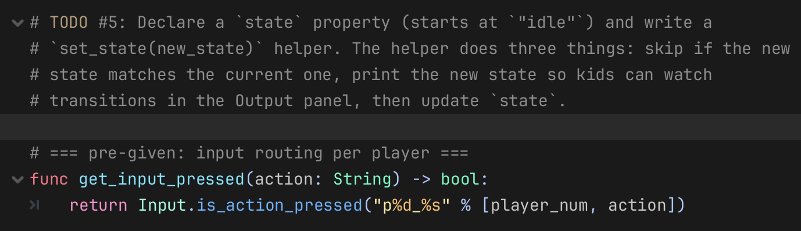
iCode
DAY 4
EMPOWERING FUTURE INNOVATORS
Back to player.gd
Where you'll type it — player.gd:63-72
55

Slide 47
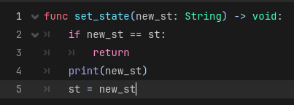
iCode
DAY 4
EMPOWERING FUTURE INNOVATORS
Declare state (start at "idle"). In set_state(new_state) return if it matches the current state, otherwise print new_state and update state.
Pattern (board example):
Where in your code (Godot):
56

Slide 48
iCode
DAY 4
EMPOWERING FUTURE INNOVATORS
No new visible payoff
State is declared. But nothing reacts to it yet — chunk #6 fills the branches. Keep going.
57

Slide 49
iCode
DAY 4
EMPOWERING FUTURE INNOVATORS
Use the state — make the panda behave per state
The state string exists. Now write the rules: what does each state DO every frame?
58

Slide 50
iCode
DAY 4
EMPOWERING FUTURE INNOVATORS
match state: — six branches
• _physics_process(delta) runs every frame (~60×/second).
• Inside it: match state: checks the current state string.
• Six branches: "idle", "walk", "jump", "fall", "attack", "hit".
• Each branch runs ONLY when the fighter is in that state.
59

Slide 51
iCode
DAY 4
EMPOWERING FUTURE INNOVATORS
What's written vs what you write
• Pre-given (gray):
• The match state: dispatcher itself
• Velocity application (gravity, horizontal movement)
• attack branch (full — you wrote attack() in chunk #7)
• hit branch (full — uses hit_flash_timer)
• dead branch (full — freezes the fighter)
• You write (red — 4 holes):
• Inside "idle": when to switch to "walk" and "jump"
• Inside "walk": when to switch to "idle" and "jump"
• Inside "jump": when to switch to "fall"
• Inside "fall": when to switch to "idle"
60

Slide 52
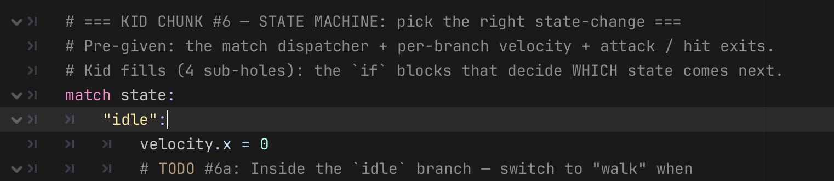
iCode
The full state machine — your four holes
DAY 4
EMPOWERING FUTURE INNOVATORS
62

Slide 53
iCode
TODO #6 — State Machine (player.gd)
DAY 4
EMPOWERING FUTURE INNOVATORS
#6a "idle" state exits
#6b "walk" state exits
← Chunk #6 · inside match state:
← Chunk #6 · inside match state:
"idle":
if get_move_direction() != 0:
set_state("walk")
if get_input_just_pressed("jump") and is_on_floor():
velocity.y = -jump_impulse
set_state("jump")
"walk":
if get_move_direction() == 0:
set_state("idle")
if get_input_just_pressed("jump") and is_on_floor():
velocity.y = -jump_impulse
set_state("jump")
#6c "jump" state exit
#6d "fall" state exit
← Chunk #6 · inside match state:
← Chunk #6 · inside match state:
"jump":
if velocity.y > 0:
set_state("fall")
"fall":
if is_on_floor():
set_state("idle")

Slide 54
iCode
DAY 4
EMPOWERING FUTURE INNOVATORS
Make the attack DO something
Fighters can move. Now make the attack key actually deal damage.
67

Slide 55
iCode
DAY 4
EMPOWERING FUTURE INNOVATORS
match attack_type: — two branches
• attack_type is "melee" or "projectile" (set by chunk #2 / setup()).
• Inside attack(): match attack_type: branches once — melee hits the nearby opponent directly; projectile fires a scene instance.
• Same match pattern as the state machine — one string decides what happens.
68

Slide 56
iCode
DAY 4
EMPOWERING FUTURE INNOVATORS
Pieces already in the file
• attack_cooldown_timer — pre-given float; set to attack_cooldown to start the cooldown.
• melee_swing_timer — pre-given float; set to 0.15 to trigger the swing rectangle draw.
• queue_redraw() — pre-given Godot call; redraws the swing rectangle.
• get_opponent() — pre-given method; returns the other Player node (or null if dead).
• spawn_projectile() — pre-given method; fires a Projectile scene in the facing direction.
69

Slide 57
iCode
DAY 4
EMPOWERING FUTURE INNOVATORS
The same check with named booleans: three readable lines instead of one unreadable wall. If it breaks, you know which condition failed.
Pattern (board example):
# BAD — one wicked one-liner:
if abs(opponent.pos.x - pos.x) < rng \
and abs(opponent.pos.y - pos.y) < 40 \
and sign(opponent.pos.x - pos.x) == facing:
opponent.take_damage(dmg)
70

Slide 58
iCode
DAY 4
EMPOWERING FUTURE INNOVATORS
Why abs()? Distance has no direction.
• When your opponent moves to the LEFT, their x position goes DOWN — so the gap between you becomes a negative number.
• When your opponent moves to the RIGHT, their x position goes UP — so the gap is a positive number.
• But you're the same distance apart either way! The sign just tells you which side they're on.
• abs() throws away the sign and gives you the plain distance — like a tape measure that doesn't care which direction you hold it.
• abs(−300) = 300 abs(+300) = 300

Slide 59
iCode
DAY 4
EMPOWERING FUTURE INNOVATORS
What breaks without abs()
❌ Without abs()
✅ With abs()
Your attack range is 70 pixels. Your opponent is way over to the left — 300 pixels away. The gap comes out as −300 (negative because they're to your left). The game checks: is −300 ≤ 70? → YES — so the punch lands! But they're 300 pixels away. That punch should never have hit.
Your attack range is 70 pixels. Your opponent is way over to the left — 300 pixels away. The gap comes out as −300. abs(−300) turns that into 300. The game checks: is 300 ≤ 70? → NO — punch misses. Correct! Now it works the same no matter which side they're on.

Slide 60
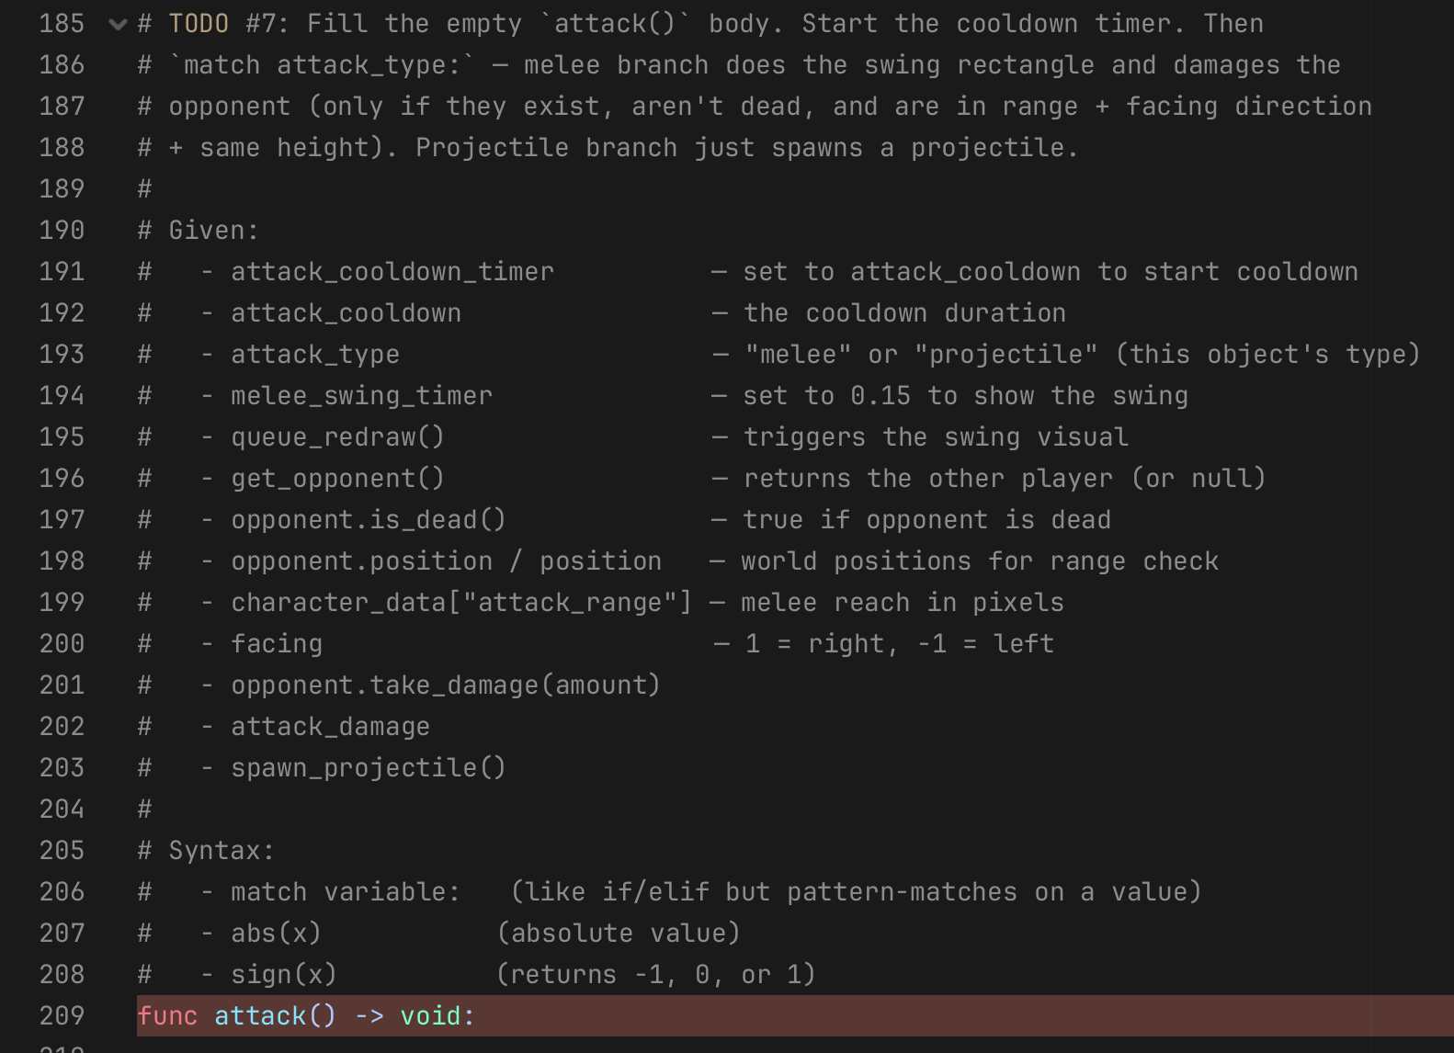
iCode
DAY 4
EMPOWERING FUTURE INNOVATORS
Pattern (board example):
# Named booleans — the good way:
var in_range = abs(to_opp.x) < attack_range # pre-given
var same_height = abs(to_opp.y) < 40.0 # pre-given
var facing_opponent = sign(to_opp.x) == facing # YOU write this
if in_range and facing_opponent and same_height: # YOU write this
opponent.take_damage(attack_damage)
Where in your code (Godot):
72

Slide 61
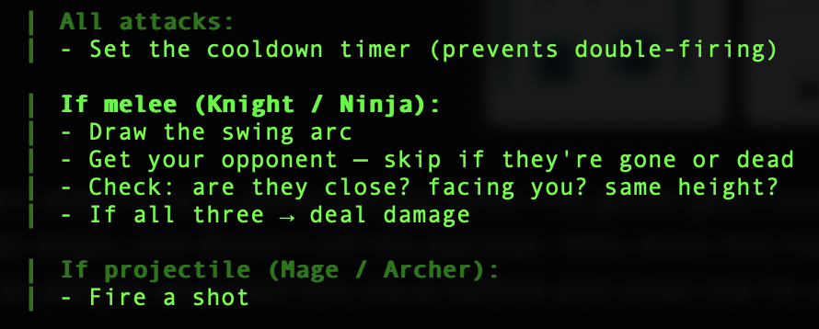
iCode
DAY 4
EMPOWERING FUTURE INNOVATORS
This one is a little spicy.
Your code needs to decide 3 things:
Can I attack? (cooldown timer handles this automatically)
What kind of attack am I? (Projectile/Melee)
Did I actually hit? (Melee only – close enough, facing you, same height?)
72

Slide 62
iCode
DAY 4
EMPOWERING FUTURE INNOVATORS
Make it yours
73

Slide 63
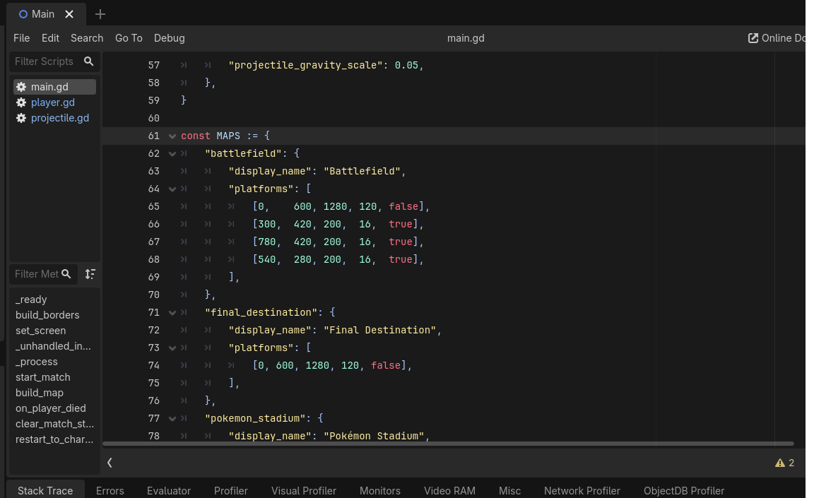
iCode
DAY 4
EMPOWERING FUTURE INNOVATORS
Beat 5 — Add a fifth map
74

Slide 64
iCode
DAY 4
EMPOWERING FUTURE INNOVATORS
Change the map colors to match your theme
74

Slide 65
iCode
DAY 4
EMPOWERING FUTURE INNOVATORS
Final Challenge time
Invent a 5th fighter: custom stats, custom sprite, custom attack. Then fight your friend with it.
75

Slide 66
iCode
DAY 4
EMPOWERING FUTURE INNOVATORS
What you unlock
• Build a 5th playable character with whatever stats, sprite, and attack type you want.
• Give them a custom attack: invent the behavior — projectile burst, screen shake, freeze, anything.
• Play it against your friend in the map you built in Beat 5.
77

Slide 67
iCode
DAY 4
EMPOWERING FUTURE INNOVATORS
More ideas — stats
• Max walk_speed before clipping through walls: ~800. Above 1000 = chaos.
• jump_impulse = 1000 → moon jump.
• attack_cooldown = 0.05 → machine gun attacks.
• attack_damage = 99 → one-punch.
• Combine: slow + high damage = tank. Fast + low damage = glass cannon.
84

Slide 68
iCode
DAY 4
EMPOWERING FUTURE INNOVATORS
More ideas — attack behavior
• Two projectiles: call spawn_projectile() twice with a tiny delay trick.
• Area burst: opponent.take_damage(attack_damage) without checking in_range — always hits if facing.
• Boomerang: set projectile_gravity_scale to a negative value in the dict.
• Self-heal: instead of damaging the opponent, call hp = min(hp + 10, max_hp).
• Taunt: call set_state("attack") without dealing damage — wastes the opponent's dodge.
85

Slide 69
iCode
DAY 4
EMPOWERING FUTURE INNOVATORS
You already know how to do this
• FC-1 ← chunks #1 + #2 (property declarations → a fresh stats dict)
• FC-2 ← chunk #4 (hook a new instance into the existing system)
• FC-3 ← chunks #6 + #7 (add a new match branch + invent attack behavior)
• Every FC hole is a reword of something you wrote this morning.
78

Slide 70
Day 4 -- Adding a 5th Character Steps 1-3 of 6 -- main.gd
Step 1 — Add entry to CHARACTERS (main.gd)
Step 2 — Add name to keys list (main.gd)
Step 3 — Expand key capture range (main.gd)
"yourchar": {
"display_name": "YourChar",
"sprite": "res://assets/.../tile_0003.png",
"tint": Color(1.0, 0.5, 0.0),
"walk_speed": 250.0,
"jump_impulse": 500.0,
"attack_type": "melee",
"attack_damage": 20,
"attack_cooldown": 0.6,
"attack_range": 70.0,
"projectile_speed": 0.0,
"projectile_gravity_scale": 0.0,
},
var keys = [
"knight", "ninja",
"mage", "archer",
"beast", "yourchar"
]
# Before (captures keys 1-5):
event.keycode <= KEY_5
# After (captures keys 1-6):
event.keycode <= KEY_6
_unhandled_input() • name must match Step 1 key exactly
_unhandled_input() • change the upper bound to match your new key number
melee needs attack_range > 0 | projectile needs projectile_speed > 0

Slide 71
Day 4 -- Adding a 5th Character Steps 4-6 of 6 -- main.gd / player.gd
Step 4 — Update selection guard (main.gd)
Step 5 — Update menu display text (main.gd)
Step 6 — Add attack branch (player.gd)
# Before (both char_select branches):
if key_num >= 1 and key_num <= 5:
p1_choice = keys[key_num - 1]
# After:
if key_num >= 1 and key_num <= 6:
p1_choice = keys[key_num - 1]
# Find title_label.text in set_screen().
# Add your character at the end:
"P1 — pick your fighter:\n"
"1=Knight 2=Ninja 3=Mage\n"
"4=Archer 5=Beast 6=YourChar\n"
"(Space confirms)"
# In attack() match attack_type:
"custom":
var opp = get_opponent()
if opp == null or opp.is_dead():
return
opp.take_damage(attack_damage)
# hp += 10 # heal instead
# spawn_projectile() # fire shot
_unhandled_input() • change in BOTH char_select_p1 and char_select_p2 branches
set_screen() • update BOTH "char_select_p1" and "char_select_p2" text strings
Only needed if attack_type is "custom" — skip for melee or projectile

Slide 72
iCode
DAY 4
EMPOWERING FUTURE INNOVATORS
Objects + State. Two big ideas.
• OBJECT — a thing in code that remembers its own data and can do things. Every fighter is one Player object with its own hp, walk_speed, and state.
• STATE — a mode that changes the object's behavior every frame. Six states: idle, walk, jump, fall, attack, hit/dead.
• Together: a fighter that knows what it is AND what it's doing. That's a game character.
86

Slide 73
iCode
DAY 4
EMPOWERING FUTURE INNOVATORS
Tomorrow: Day 5
No new code. Play what you built across four days, show it off, and take it home.
87

Slide 74
iCode
DAY 4
EMPOWERING FUTURE INNOVATORS
Export’n time
.exe bro, ain’t no other way to go
88

